Slide 1
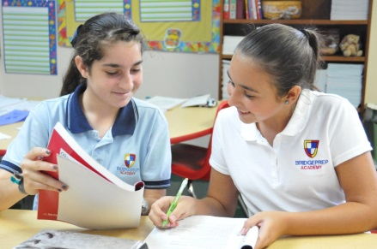
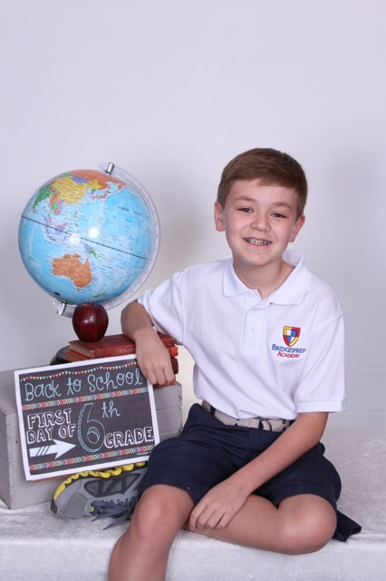
Welcome to Our School Family!
BridgePrep Academy of South Tampa
www.BridgePrepTampa.com

Slide 2
Our Mission Statement
BridgePrep Academy believes every child learns best in a safe, nurturing and stimulating environment where high academic expectations, self-esteem, good character and an appreciation for the arts are promoted.
BridgePrep Academy’s mission is to provide a challenging academic curriculum that will encompass an extended Spanish language program, technology and experiences that will enable students to develop in all areas. BridgePrep Academy’s goal is to educate well rounded individuals and enable students to reach their maximum potential.
Notes:
Introductions

Slide 3
BridgePrep Academy Leadership Team
Principal:
Christine Harris
Assistant Principal:
Suzanne Mizzi
Instructional Coach:
Sameer Saklani
Student Services Director:
Victoria Klug

Slide 4
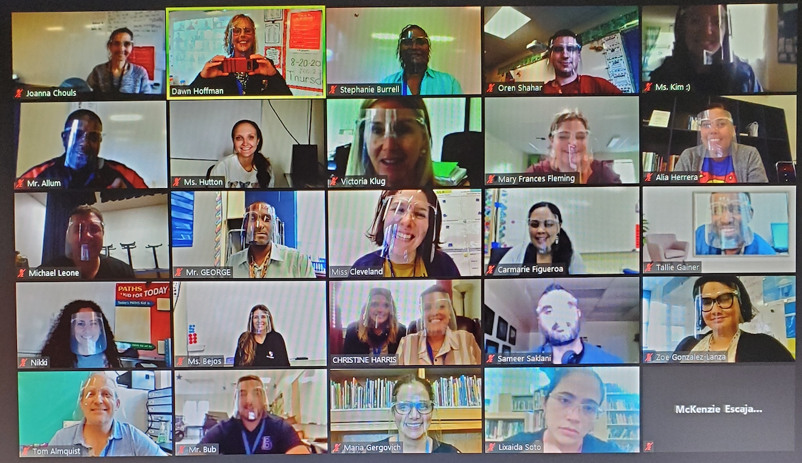
2020-2021 Faculty

Slide 5
2020–2021 Staff
Treasurer & Data Processor Lead: Janice Brewton
Registrar & Operational Manager: William Castro
Aftercare Director: Angela McCarthy
IT Lead: Donald Dennis
Security: Terri Hall & Donald Dennis
Receptionist/Clerk: Renee Valdez
Receptionist/Clark PLC: Olivia Bolden
Cafeteria Manager: Genesis Carrion-Vazquez
Cafeteria Aids: Dalia Gonzalez & Olivia Bolden
Custodial: Mary Espinosa & Liz Maurer

Slide 6
Keys to Our Success
Highly Qualified Teachers and Administrators
Rigorous Academic Curriculum
Extended Secondary Spanish Language Model
Safe & Nurturing Learning Environment
Parental Involvement and Participation
Maintaining School’s Financial Viability

Slide 7
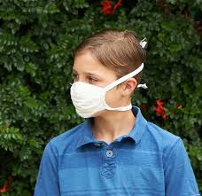
SAFETY IS OUR #1 PRIORITY AT BRIDGEPREP ACADEMY
Notes:
Talking points . Students required solid color face masks. Masks should be worn at all times other than while eating or drinking.

Slide 8
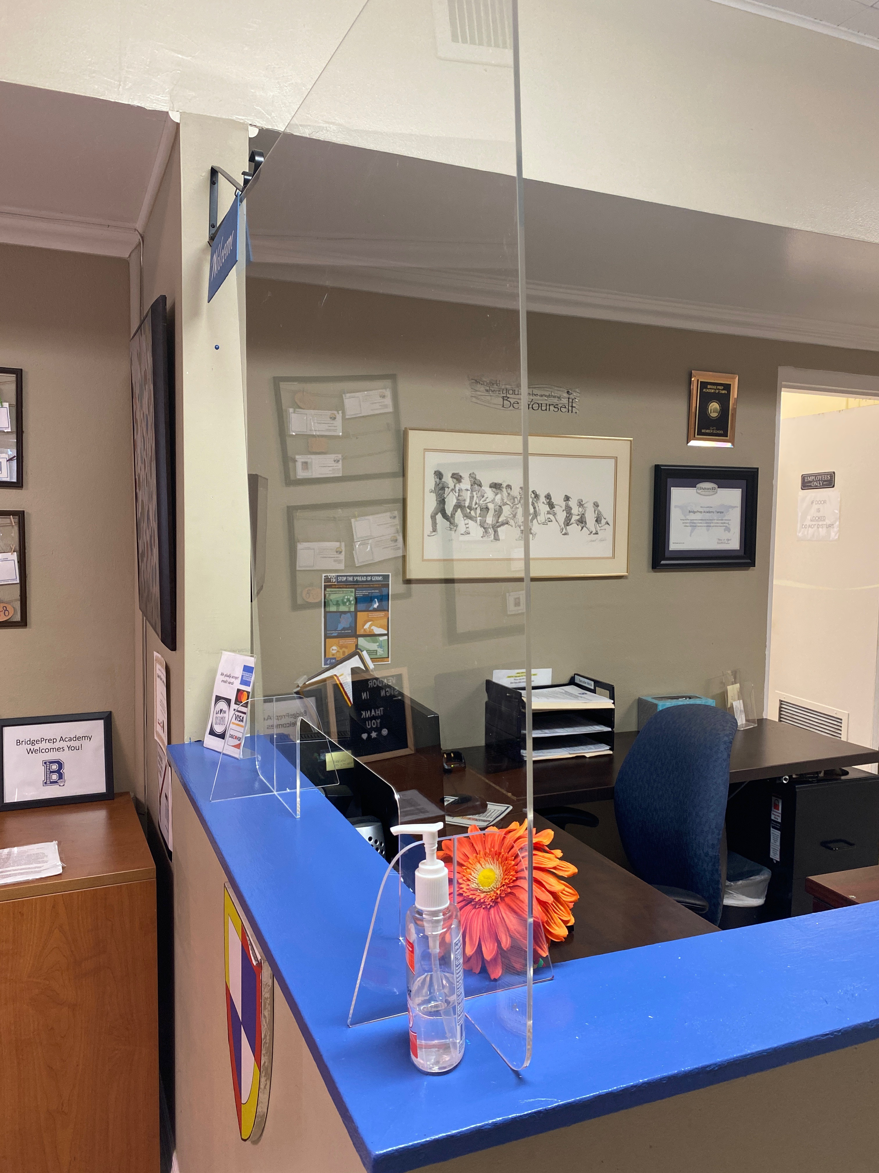
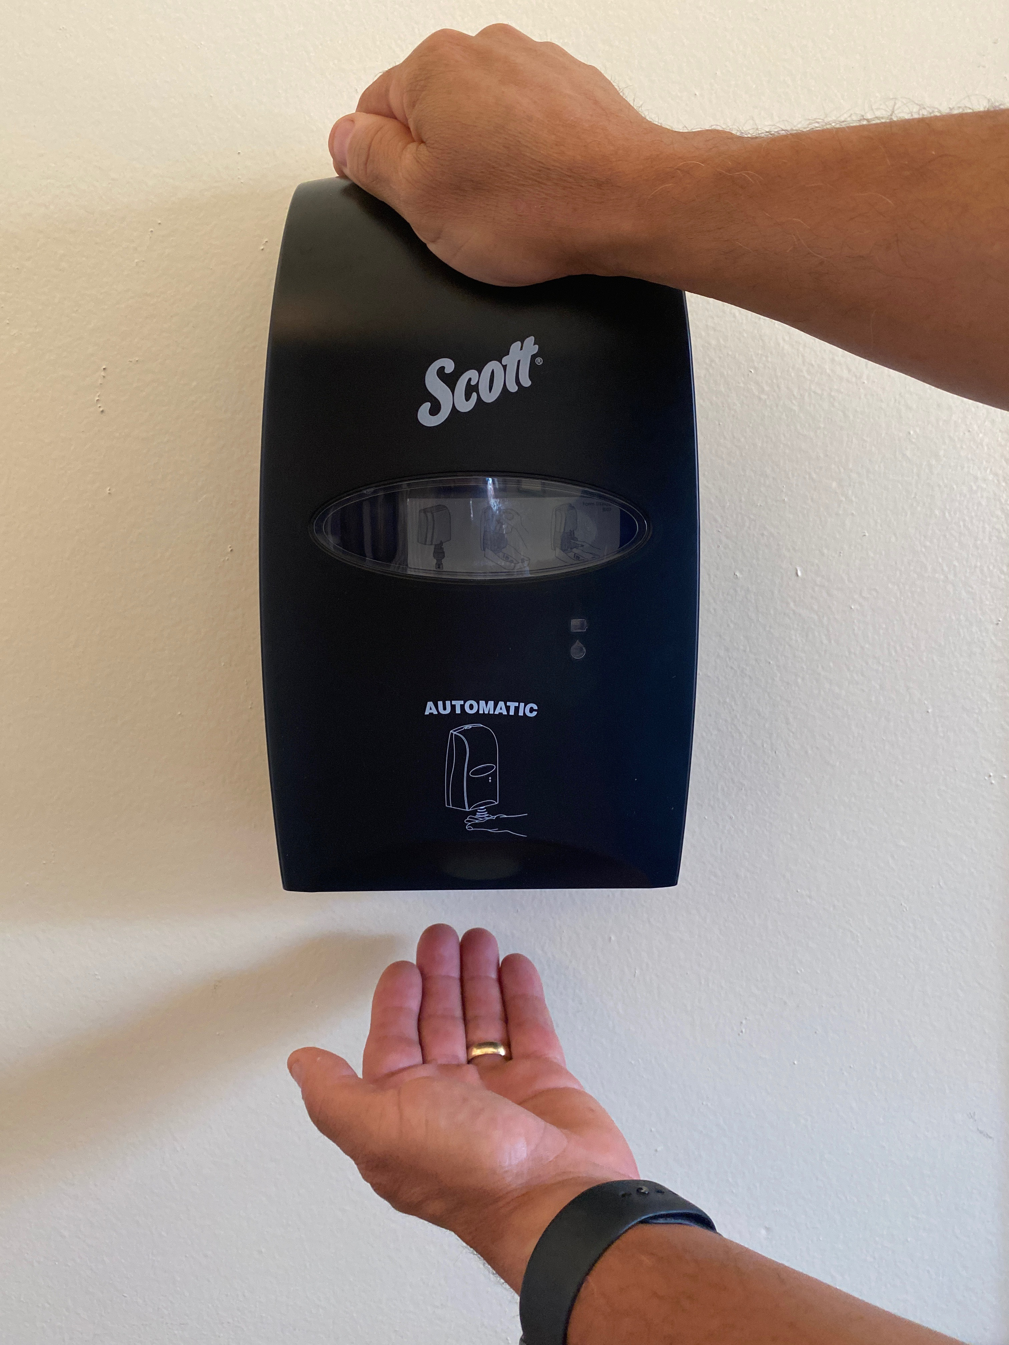
SAFETY FIRST!
Notes:
WE HAVE INSTALLED MULTIPLE HAND SANITIZER DISPENSERS THROUGH THE SCHOOL HOUSE AND PLC. There are Bridgeprep stickers to remind students to social distance when in the common areas of the campus and can be found throughout the campus. Plexi glass protectors have been installed by our receptionist stations.

Slide 9
WATER BOTTLES
All water fountains are temporarily turned off
Please send your child to school daily with a few bottles of water
Label all water bottles with your child's name
Notes:
Water fountains have been turned off in order to limit cross contamination. They must send their child to school with ample bottle of water for hydrating.
Especially at PE

Slide 10
Health Awareness

Slide 19
SHOWER DAILY AND WASH UNIFORMS/CLOTHING DAILY
Notes:
We ask that in order to keep your children and all our staff safe you was all clothing daily preferable in hot water. Student should shower daily

Slide 20
BridgePrep UNIFORMS On Zoom (eLearning) In Classrooms (F2F)

Slide 21
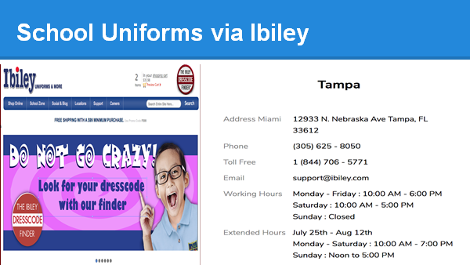

Slide 22
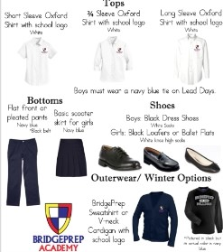
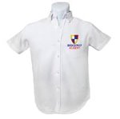
Middle School Lead Day- Our Student Leaders are Celebrated
Notes:
ONCE A WEEK WE ASK THAT OUR MIDDLE SCHOOL STUDENTS WEAR BUISINESS PROFESSIONAL ATTIRE. Once a month we are blessed with community members who give back by sharing their life experiences with our students. We have had authors, military, chefs, actors, dancers, make up artists, motivational speakers, law enforcement, secretaries, bankers and so many more careers shared with our students.
Navy pants or knee length skirt
White Oxford button down short sleeve or long sleeve shirt with school logo
Black closed-toe dress shoes with socks (No heels)
Navy blue cardigan with school logo

Slide 23
MASKS ARE MANDATORY
Notes:
Masks and Solid All students must wear masks on campus k-8
They must be solid with no design to eliminate distracting others

Slide 24
Spirit Shirts: ONLINE STORE Visit Bridgepreptampa.com
ELEMENTARY Kindergarten-4th Grade
5th Grade- 8th Grade
Notes:
https://secure.educationalnetworks.net/apps/s/index.jsp?ech=www.bridgepreptampa.com&s=4637
All purchases will be made online and shirts will be mailed to school. Once we receive all orders you will be notified and we will schedule pickup. Also we now offer a BPA hoodie for all grades k-8.

Slide 25
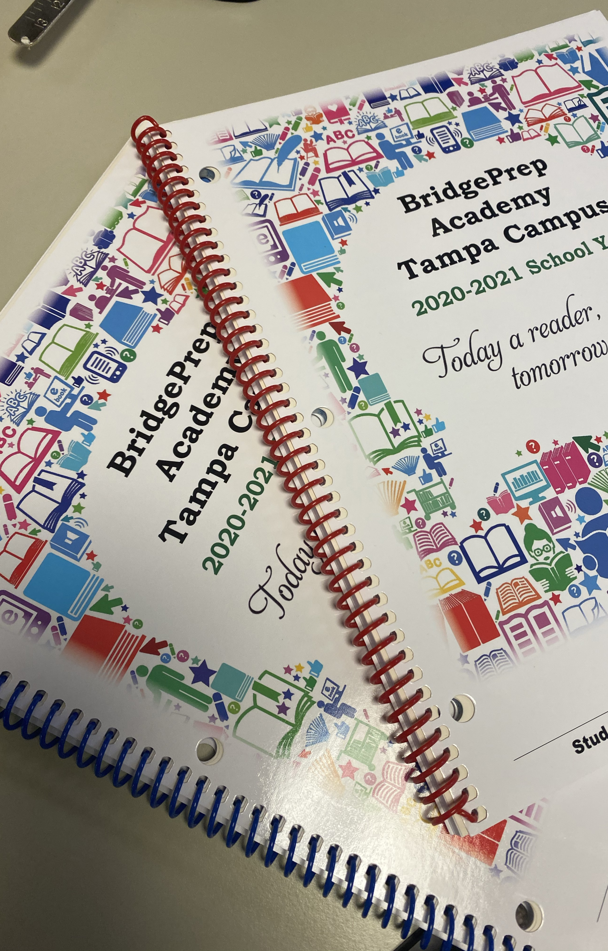
AGENDAS/PLANNERS Mandatory For ALL Grades
COST $7.00
Brick and Mortar purchase from your homeroom teacher.
Remote Learners we will be sending out information soon about picking up at the school.
STAY CONNECTED
Notes:
$ 7.00 Brick and mortar students may bring the money and purchase from their homeroom teachers. Remote students we will be sending out a schedule so that you may come at your convenience pay and pick up your mandatory planner

Slide 26
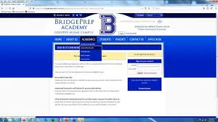
COMMUNICATION IS KEY
Notes:
Discuss all the ways parents can stay connected. We use Class dojo for grades k-4 and MyKidsbank Behavior tracker for grades 5-8
ZOOM STUDENTS SHOULD BE INTERACTING WITH THE TEACHER

Slide 27
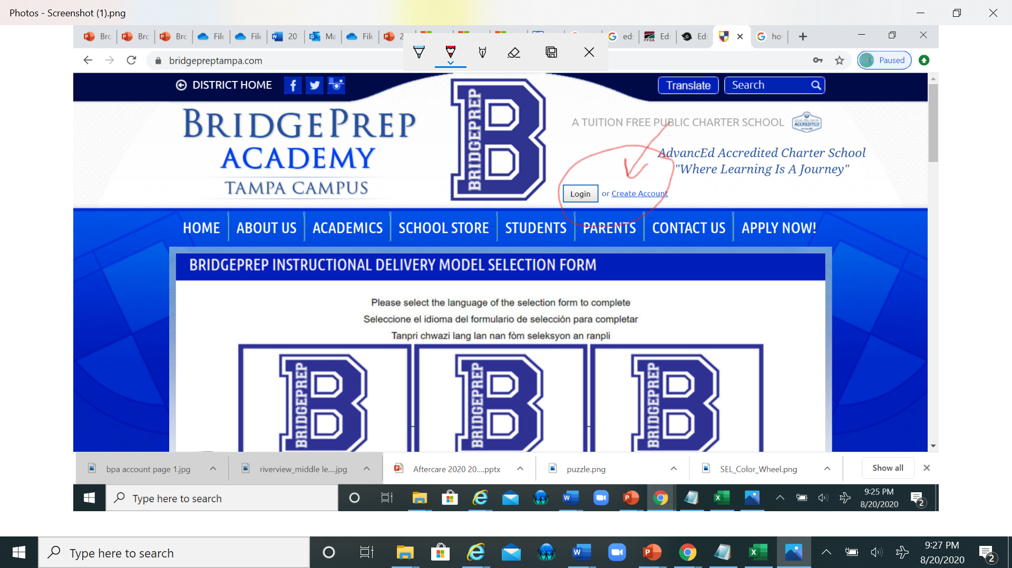
BridgePrepTampa.com REMOTE CLASS INFORMATION
https://www.bridgepreptampa.com/
Edu Network is where your child will go to see all assignments, messages, and feedback from your teachers.
Schedules and Zoom links for all of their classes.
It is their remote classroom
Notes:
GO TO BRIDGEPREPTAMPA.com FOR INFORMATIONAL VIDEO! Create and account!

Slide 28
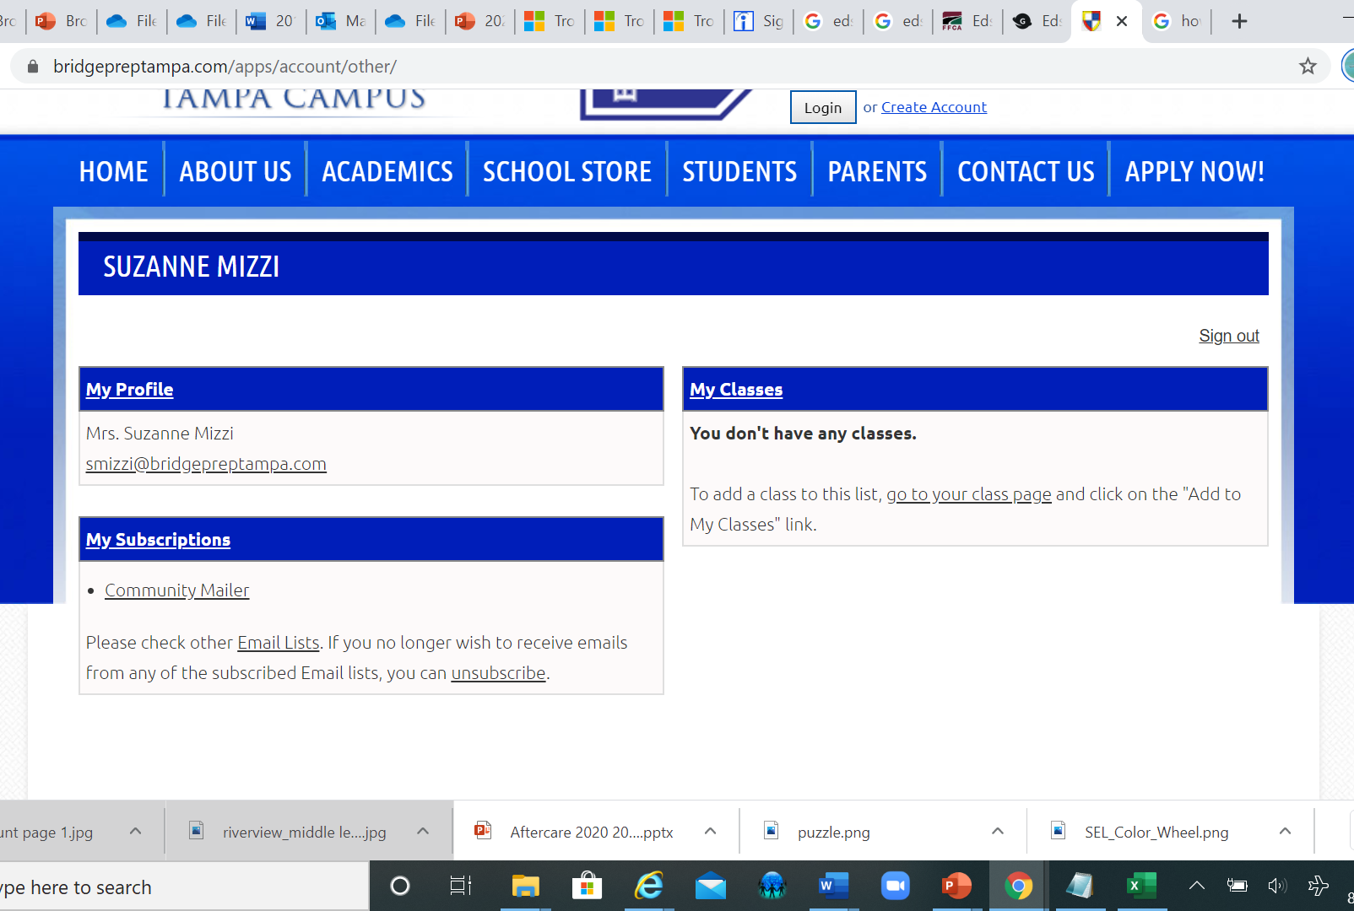
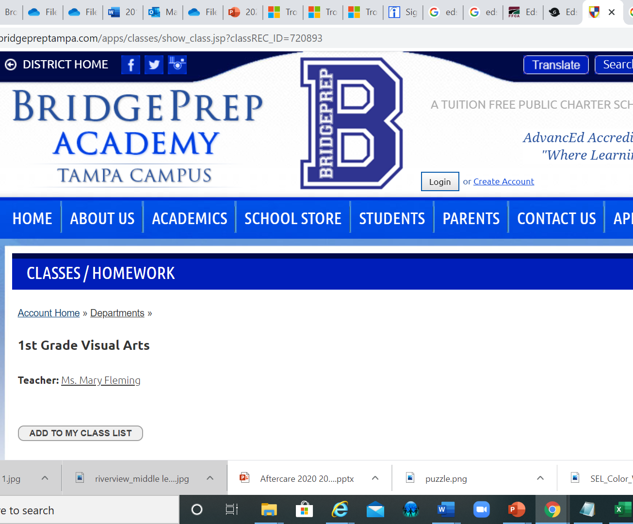
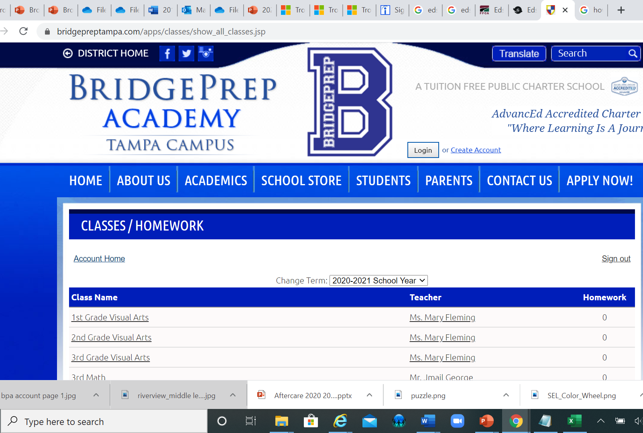
Notes:
Once you have created an account and signed in you will be verified and then you can begin picking your classes from the list of courses. click on the course and then add it to your schedule. The teacher will verify and you will be set up for the classes.
Creating an account
https://www.youtube.com/watch?v=88o3qxioiJI&list=PL3O20M7DyIpybhYOgWmFZre46XZDVrz0G&index=6&t=0s
Uploading Assignments into EDUNETWORK We have a good video about submitting Homework assignments here: https://www.youtube.com/watch?v=uLzgv-hVnso&list=PL3O20M7DyIpybhYOgWmFZre46XZDVrz0G&index=7&t=0s

Slide 29
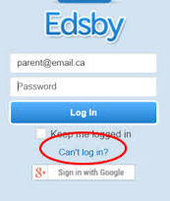
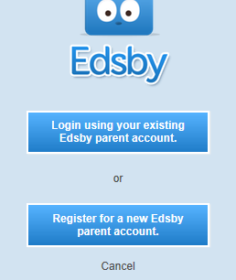
Edsby
EDSBY is BridgePrep's Grading Platform
If you have problems accessing your child's account please call 813-840-7047
Notes:
https://www.edsby.com/help/parents/

Slide 31
eLearning / Remote
ZOOM LINKS
Simutaneous Classroom Instruciotn
Interact with peers
Morning meeting schoolwide (link)
Uniform required
Parents are not to interact during these classes
Should you have a question, please call or email the teacher
Notes:
Parents need not interact only students will be interacting

Slide 32
Returning to School Building
Arrive on time
Car line Only No walk ups Temperatures taken in vehicle (prepare for slow entry)
No entry into building by anyone other than students and faculty

Slide 33
RETURNING: TEMPERATURE CHECKS THROUGOUT DAY
Notes:
Students temperatures will be checked upon arrival to school and again a few hours later. Every child will be checked a minimum of twice per day. If we find that a student is running a temperature parents/guardians will be called.

Slide 34
Grade Level | Day of the Week | Times
Kindergarten and 1st grade | Tuesday through Friday | 8:00am to 2:45pm
2nd to 8thgrade | Tuesday through Friday | 8:00am to 3:30pm
Kindergarten to 8th grade | Student Early Release Days One-hour early release every Monday with the following exceptions: May 10, 17 and 24 2021 and Last day of school: 2.5 hours early | 8:00am to 2:30pm

Slide 35
BPA Basics

Slide 36
SOCIAL EMOTIONAL LEARNING: FRAMEWORKS
SEL WHEEL
COMMUNITY BUILDING OPPORTUNITIES: MORNING MEETINGS
Notes:
We are so blessed to be one of 2 school in Hillsborough to receive this 20 thousand grant program. Partnered up with Frameworks our Social and emotional learning (SEL) enhances students’ capacity to integrate skills, attitudes, and behaviors to deal effectively and ethically with daily tasks and challenges. Every morning K- 8th grade will be participating in some form of activity during the daily morning meet up. This give students the opportunity to get ready to learn.
Through this program BPA promote intrapersonal, interpersonal, and cognitive competence for all students all ages.

Slide 37
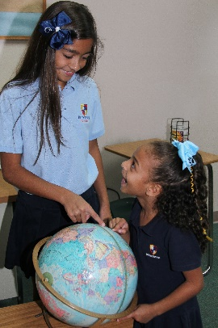
Instructional Support
In addition, students will utilize the implementation of best practices and visuals to help support them and assist them with becoming independent learners of the second language.
Exceptional Student Education will be available based on
the demand of the enrolled population.
English Language Learners (ELL) will receive an entry assessment and instructional support as required by Federal & District policy.

Slide 38
HOMEWORK
Parents’ responsibility for completing home learning assignments:
Provide your child with a quiet place which is conducive to studying and to learning.
Show an interest in your child’s home learning assignments by providing assistance and reviewing completed work.
Do not complete the home learning assignments for your child. If your child is having difficulty, try to help them with their assignment and notify the teacher.
Read with or to your children daily.

Slide 39
HOMEWORK
Grade Level | Frequency of Assignments | Total Daily Average (All Subjects)
K – 1st grade | Daily (4 days per week) | 45 minutes
2nd – 3rd grade | Daily (4 days per week) | 60 minutes
4th – 8th grade | Daily (4 days per week) | 75 minutes
All Grades | Daily (5 days per week) | Reading for 30 minutes in addition to above time.
Notes:
For our face to face not our remote students

Slide 40
Grade Report Cards
Periods:
Q1- Aug 24-Oct 23, 2020
Q2 Oct 26- Jan 15, 2020
Q3 Jan 18- Mar 26, 2020
Q4 Mar 29 –May 28,2021

Slide 41
ATTENDANCE AND PUNCTUALITY IS MANDATORY
It is an educational fact that attendance and grades are connected.
All students (Brick and Mortar, Hybrid and Remote) must attend regularly and be on time
We expect our students to demonstrate excellent attendance.
Please make every effort to have your child attend school on time consistently.

Slide 42
Absenteeism Policy
Students are to be counted in attendance only if they are actually present for at least two hours of the day or engaged in a school-approved educational activity which constitutes a part of the instructional program for the student.

Slide 43
TARDY POLICY
Any student arriving after 8:05am will be issued a late pass and marked tardy. After ten (10) unexcused tardies, the student will be issued a referral form that will be placed in the student’s permanent record.

Slide 44
LUNCH PROGRAM
LUNCH
It is required that all students eat a healthy and nutritious lunch.
A student may bring their lunch to school or purchase lunch from our vendor. School lunches price to be determined, please refer to first day school packet for additional information. If your child qualifies for free or reduced lunch arrangements will be made accordingly.
Students who bring lunch bags/boxes must bring them upon arriving to school. NO NUT ITEMS PERMITTED FOR ANY STUDENT. NO GLASS BOTTLES OR CONTAINERS.
Notes:
We have staggered lunch so that we continue to practice social distancing. Students and teachers have been assigned their areas to eat lunch safely.

Slide 45
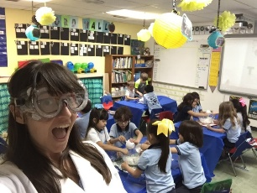
ENRICHMENTS
TUTORING
Music Club
Garden Club
Student Council
National Honor Societies
Dance
Yoga
Sports

Slide 46
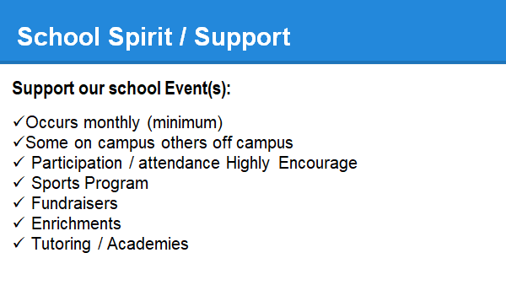

Slide 47
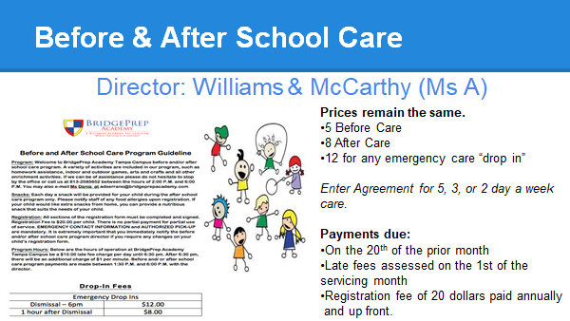
Notes:
SEE SLIDES ON AFTERCARE FOR INFORMATION!

Slide 48
Dismissal Process
CAR CIRCLE (School House):
-ONE WAY IN ONE WAY OUT
- REQUIRED DROP OFF FRONT ADMIN
-DIRECTED BY STAFF
-PLEASE STAY OFF YOUR PHONES
-STOP AT THE STOP SIGN
-PLACE YOUR CHILDS NAME AND GRADE ON THE DASHBOARD AND VISIBLE
-CHILD IS BROUGHT TO YOUR CAR
-STAFF LOADS YOUR CHILD SAFELY
DO NOT GET OUT OF YOUR CAR AND FOLLOW DISSMISSAL PROTOCOLS
Notes:
Parents:
Enter carline through the gate (one way) double lane
Follow direction from our staff.
Stop at stop sign
Please have your Childs Name (First and Last) and grade clearly visible on your dashboard.

Slide 49
CAR CIRCLE

Slide 50
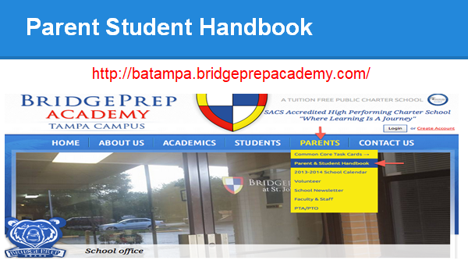

Slide 51
Questions? Please type in the chat.
AFTERCARE PRESENTATION UP NEXT
Notes:
THANK YOU !
Edunetwork IS THE SAME AS BRIDGEPREPTAMPA.com instructional platform (zoom links can be found here)
Frameworks SEL
Middle School CLASSROOM DOES NOT DO DOJO they use MYKIDSBank
THERE WILL BE NO BEFORE OR AFTERCARE ON MONDAY AUGUST 24TH.

Slide 52
MEET YOUR BPA TEACHERS!
Notes:
LINKS FOR ALL GRADES Click on your grade level Zoom link in the chat

Slide 55
